Slide 1
Security Testing Tools:

Slide 2
Security Testing Tools: Key Features
Asset detection: Automated asset detection ensures your entire IT environment is monitored for critical vulnerabilities. Static application security testing (SAST): SAST tools help developers implement security operations earlier in the software development lifecycle. Policy management: A flexible policy management system enables DevSecOps teams to enforce software quality standards during each stage of development. Threat prioritization: With automated threat prioritization, teams can focus on remediating issues that leave their systems the most vulnerable.

Slide 3

The 10 Best Security Testing Tools
Google Nogotofail: Network security testing tool for detecting known TLS/SSL vulnerabilities
Google Nogotofail is a network traffic security testing tool that helps developers and security teams monitor their HTTPS connections for common misconfigurations and known bugs. The software can detect various security weaknesses, including SSL certificate verification issues, MiTM attacks, and HTTPS and TLS/SSL library bugs.
Nogotofail supports Android, iOS, Linux, Windows, Chrome OS, and any other application or device you can connect to the internet.

Slide 4

SonarQube: Continuous code inspection app great for enforcing quality standards.
SonarQube continuously inspects code quality utilizing static code analysis. The platform generates detailed reports on bugs, code smells, vulnerabilities, and code duplications, enabling software teams to detect security issues early in development. The program supports over 25 programming languages, including Python, Java, C#, and VB.NET.

Slide 5
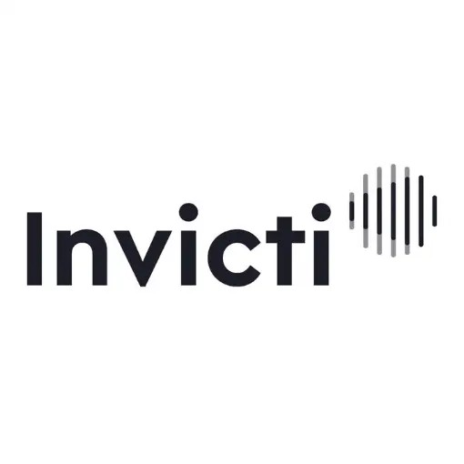
Invicti: DAST + IAST scanner that provides precise threat detection
Invicti is an enterprise black-box security scanner for identifying vulnerabilities in web applications, websites, and web services. The platform combines dynamic (DAST) and true interactive (IAST) scanning to provide extensive vulnerability coverage and precise threat detection. After vulnerabilities are found, your team can utilize Invicti’s integrations with issue tracking systems to assign them for remediation.

Slide 6

Wapiti:Open-source black-box security scanner.
Wapiti is a free security scanner that allows users to audit websites and applications for vulnerabilities. The tool performs black-box scans, meaning it doesn’t study the source code of a web page.
The scanner can detect various vulnerabilities, including SQL and XPath injections, open redirects, and subdomain takeovers. The system can also detect cross-site scripting (XSS) and differentiate between permanent and reflected XSS vulnerabilities.

Slide 7

Snyk:Developer-friendly security platform with real-time semantic code analysis.
Snyk is a developer-first security platform that automatically identifies vulnerabilities in code, open-source dependencies, containers, and infrastructure as code. Built on an industry-leading security intelligence database, Snky empowers its users to detect more vulnerabilities faster. The platform also supports various programming languages, including JavaScript, Java (Grable, Maven), .Net, Python, and Ruby.

Slide 8

SQLMap:Penetration testing software for detecting SQL injection vulnerabilities.
SQLMap is a python-based penetration testing tool that automates the detection and exploitation of SQL injection flaws and database takeovers. Penetration testers can utilize five SQL injection techniques: boolean-based blind, time-based blind, error-based, UNION query, and stacked queries. The system supports MySQL, Oracle, PostgreSQL, IBM DB2, and various other database management systems.
Once SQLMap detects SQL injection bugs in an application, testers can perform extensive database fingerprinting and execute various attacks

Slide 9

Zed attack proxy:Extensible penetration testing tool with customizable heads up display.
OWASP ZAP is a free, open-source penetration testing tool for web applications. The system supports automated and manual penetration testing. ZAP’s ease of use makes the tool accessible to users of all skill levels, from developers to security experts. Testers can utilize ZAP as a stand-alone application or daemon process. Versions of Zap are available for major operating systems and Docker.

Slide 10

Sonatype: Supply chain management solution with flexible policy engine:
Sonatype offers a suite of products that enable secure software supply chain management. Products include firewalls, application lifecycle management, auditing solutions, repository management, and security tools. Nexus Lifecycle is one of Sonatype’s security tools that helps developers protect their open-source dependencies. The tool automatically identifies and remediates open-source vulnerabilities, allowing enterprise developers to scale open source monitoring across their software supply chain.

Slide 11

Intruder: Cloud-based vulnerability scanner with automatic IP and DNS tracking tool.
Intruder is a cloud-based vulnerability scanner that identifies weak points in public and private servers, cloud systems, websites, and endpoint devices. The platform’s robust scanning engines can uncover application bugs, like SQL injections and cross-site scripting, missing security patches, and encryption weaknesses. Intruder automatically prioritizes security issues that leave your infrastructure the most vulnerable, making it easy to minimize your attack surface.

Slide 12

Vega: Java-based security scanner and testing tool for web applications
Vega is a Java based security testing tool that helps you identify vulnerabilities in your applications by finding and validating SQL injection, cross-site scripting and inadvertently disclosed sensitive information. The tool runs on Linux, Mac and Windows, and provides an automated scanner for quick tests and intercepting proxy. Vega is GUI based and is extensible, allowing you to create new attack modules using the API exposed by the app.

